Slide 1
Infrastructure deployment automation with AWS CodePipeline using Terraform
December 2022
Technical Account Manager (LTAM)
Mónica Jimena Morales A

Slide 2
Agenda
Current Situation
Goals and Benefits
Services Overview
Demo
Architecture overview
Pricing

Slide 3
Current Situation
Cloud infrastructure governance
Who, where, when, how
Costs, reutilization, naming conventions
Have the knowledge of what is implemented on the cloud (provisioned resources)
Change control
Traceability, Security
The replication of environments (development, test, QA, production, etc.)

Slide 4
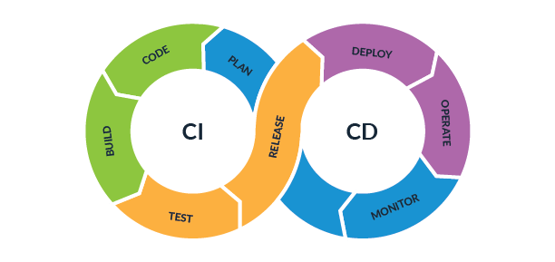
Goals and Benefits
Goals
Managing application infrastructure in a programmatic, descriptive, declarative way that can be reviewed, versioned, an deployed in an automated way – just like the application itself.
Using some techniques such as CI/CD, taken from software development best practices.
Benefits
Gain agility and speed in the deployment of the infrastructure (creation/updating)
Reduction of errors originated from prone-to-error manual tasks
Uniformity in infrastructure and scalability
Improve documentation and knowledge
Improve speed for problem resolution

Slide 5

Overview of Terraform
Open Source, Infrastructure as Code software tool created by HashiCorp, released in 2014
Supports a lot of cloud providers, such as AWS, GCP, Azure
Write declarative configuration files using HCL (HashiCorp Configuration Language) (similar to yml)
Create, update, or delete resources
Can have resources, variables, outputs
Manage the resources using 4 major commands:
terraform init
terraform plan
terraform apply
terraform destroy

Slide 6
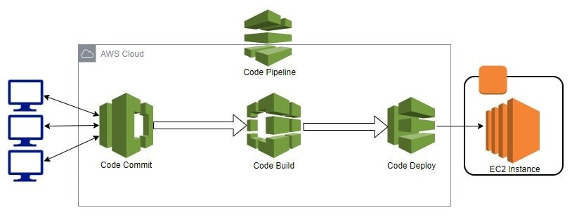
Services Overview

Slide 7
Demo

Slide 8
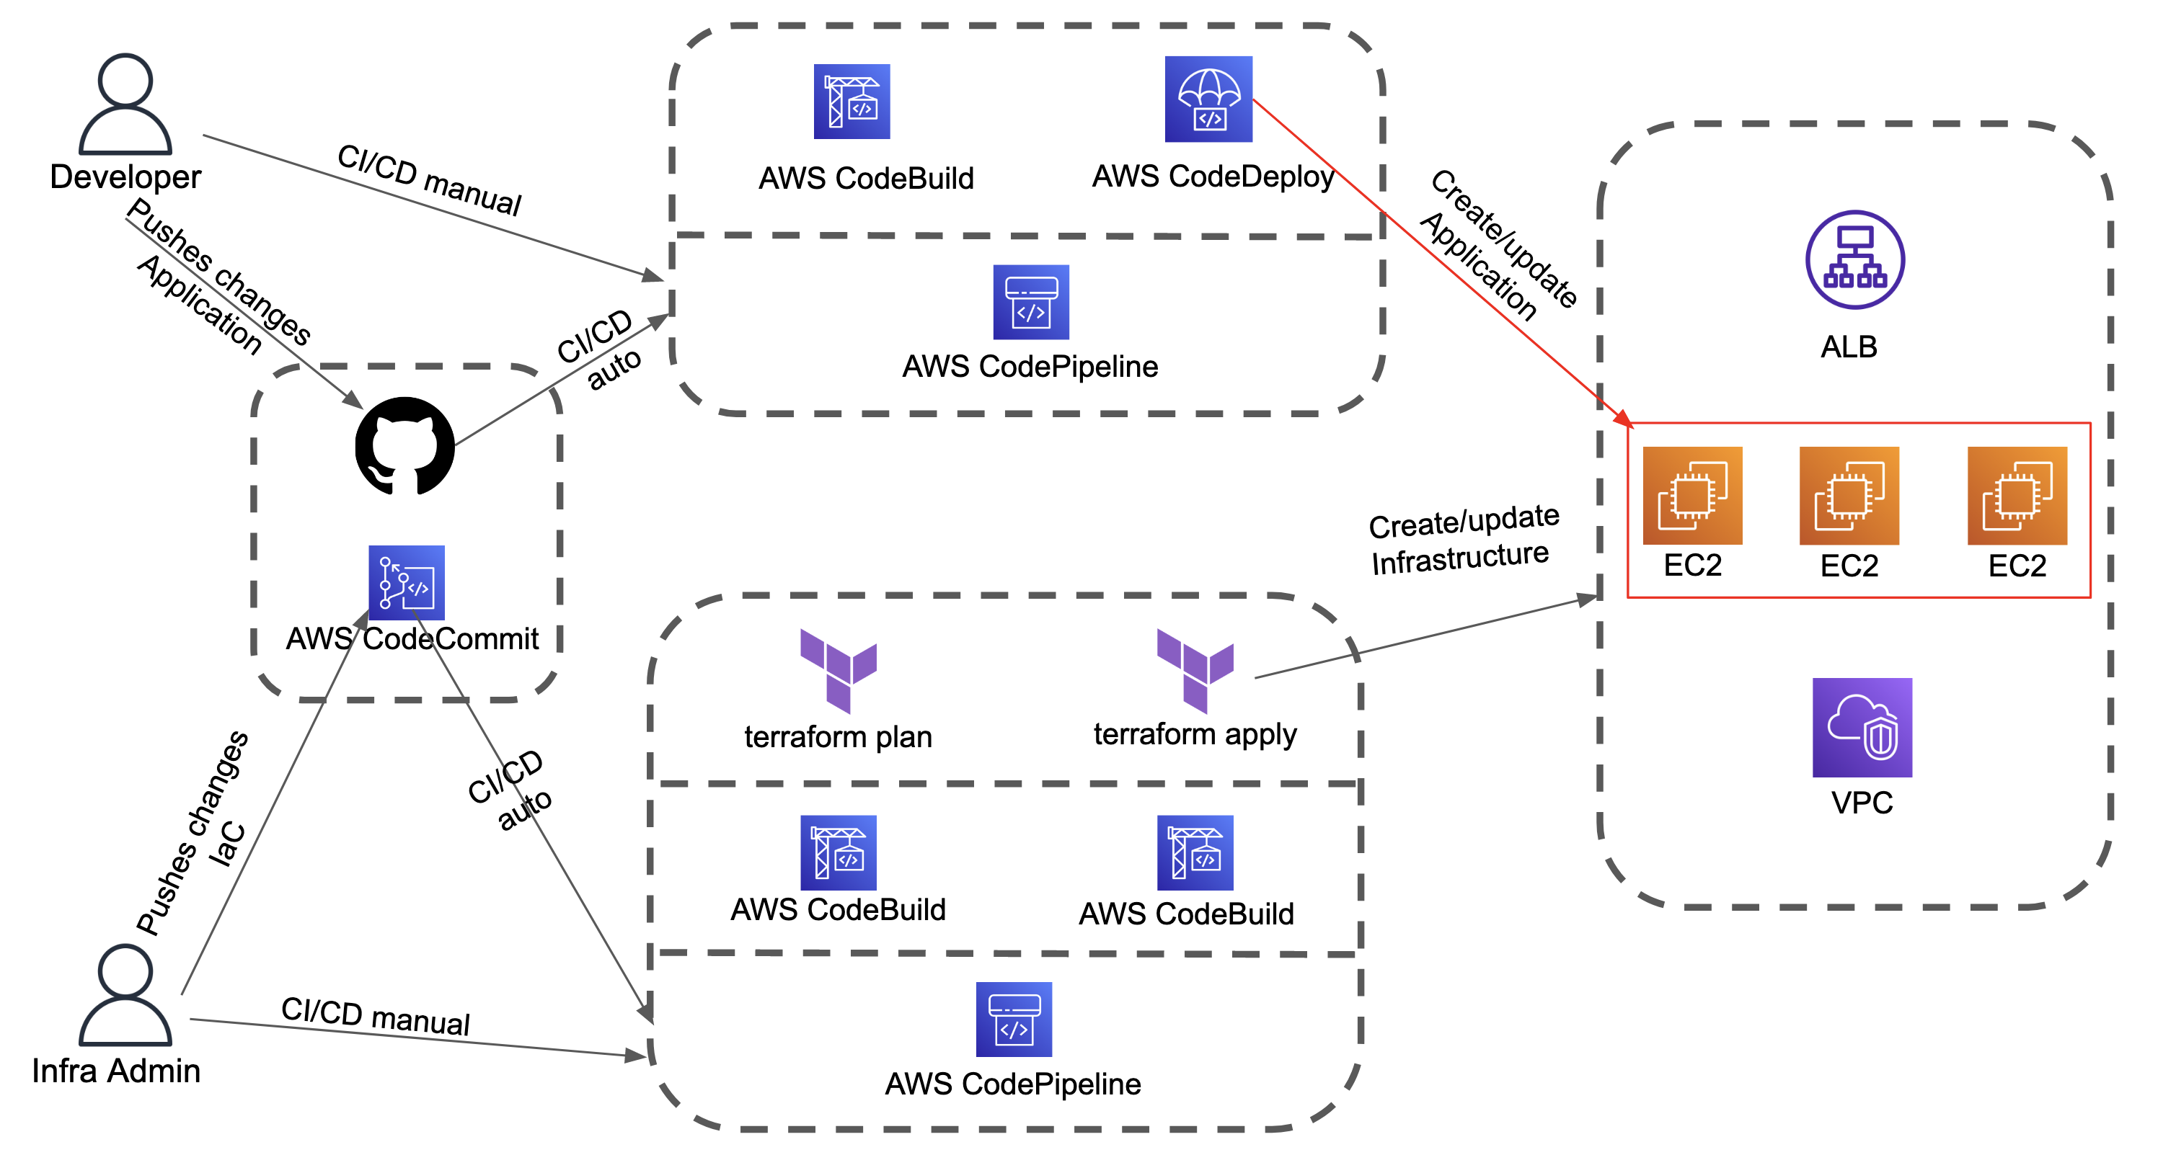
Architecture Overview

Slide 9
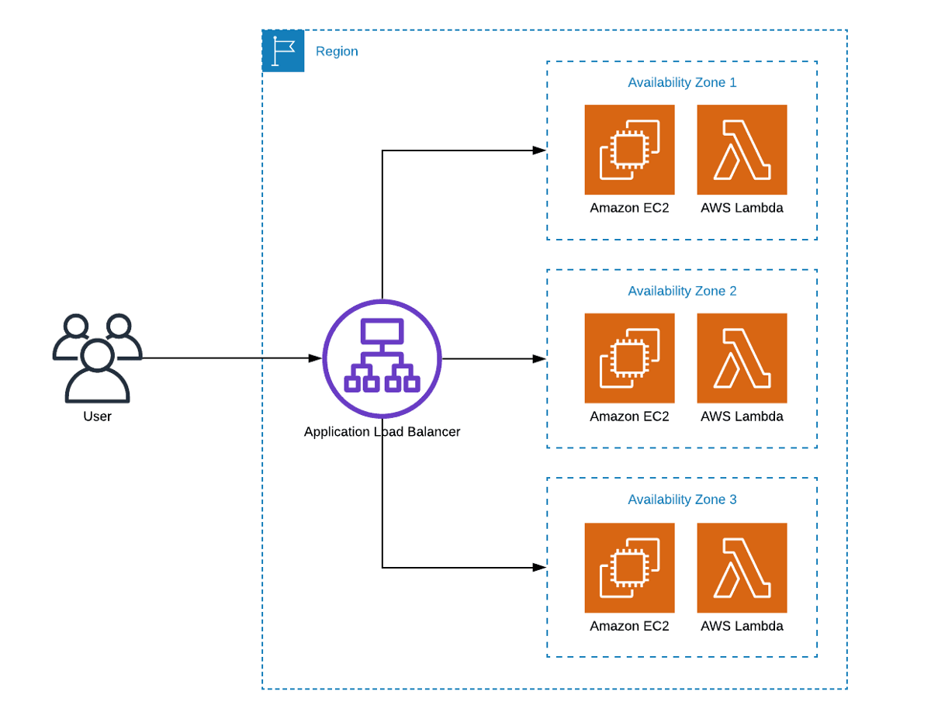
Architecture Overview

Slide 10
Pricing
CodeCommit:
First 5 active users
1000 repo per account
50 GB month of storage
10000Git requests/month
Each additional active users
$1.00 per month
CodeBuild:
You pay only for the resources you use
You are charged for compute resources based on the duration it takes for your build to execute
General1.medium (7 GB Memory – 4 vCPU)
$0.01
CodeDeploy:
There is no additional charge for code deployments to Amazon EC2, AWS Lambda or Amazon ECS through AWS CodeDeploy
For CodeDeploy On-Premises
$0,02 per on-premises instances
CodePipeline:
You pay only for what you use
$1.00 per active pipeline* per month
An active pipeline is a pipeline that has existed for more than 30 days and has at least one code change that runs through it during the month.

Slide 11
Costs Drilldown
 | AWS Code Commit | AWS Code Build | AWS Code Deploy | AWS CodePipeline
20 users | $ 15.00
100 builds in one month Each build runs for 5 minutes |  | 100 builds * 5 min = 500 build min 500 build min * $0.01 = $5,00
EC2 |  |  | $0
15 active pipelines |  |  |  | $ 15.00
Monthly Cost: $35.00

Slide 12
Thank you

